Slide 1

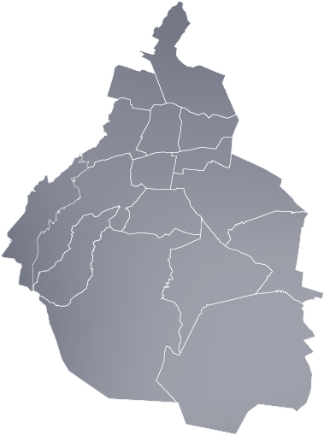


COVID-19 IMPACT IN MEXICO CITY COMMERCIAL ACTIVITY
GROUP 7

Slide 2




COVID-19 IMPACT IN MEXICO CITY COMMERCIAL ACTIVITY
Presented by:
Sonia Suárez
Control Analyst
Central Bank of Mexico
Martín Singla
Market research consultant
Frost & Sullivan
Pablo Villalpando
eCommerce Sr Manager
Grupo AlEn
Andrés Estrada
BI Analyst
HH Global
GROUP 7

Slide 3


Summary
The present document explores the different stages of Covid-19 evolution across Mexico City in 2020, and its correlation with global economic activity performance indicators.
There is a mismatch between governmental lockdown restrictions and actual Covid-19 active cases figures which rose dramatically by Q4 of 2020 when cases rose to a daily maximum of over 26 thousand active cases daily.
The deployment of governmental restrictions in early 2020 shows a correlation with the severe decrease in economic activity across all sectors (e.g.: -28% for secondary sector in Q2!). However, as restrictions were lifted by mid-late 2020, Covid-19 cases rose to an average of 13.6 thousand daily active cases during Q4 but the industry did not recover accordingly.
Nonetheless, the informal sector and street economic activities are less bound to be paralized by stringent restrictions. We explored the tentative correlation between street economic activity hubs, such as “tianguis”, and active Covid-19 cases.
A top level analysis shows that those districts with more and highly crowded street markets tend to match with those districts with higher amount of active Covid-19 cases.

Slide 4




Background, Scope & Approach
Research Inquiries
How were (1) the evolution of economic activity, (2) governmental restrictions and (3) Covid-19 spreading, interrelated at a local urban level? (Scope: Mexico City, 2020)
Can we provide some evidence of the correlation between informal and/or street economic activities and spreading of Covid-19? (Scope: Mexico City, 2020)
Explored sources
Sources: SINAVE Historico de casos COVID 19 por colonia, Economic activity measured by INEGI Index, Geo location of street market stores by Alcaldia, 2020.

Slide 5


Commercial Activity & Restrictions
Hypothesis
Effect
Effect
COVID 19 Cases
Analyze:
Number of positive cases in México city by Quarter from Jan-Dec 2020.
Restrictions placed by Government
Analyze:
Quantity & type of restrictions by Quarter.
Economic Activity
Analyze:
GDP-based macroeconomic activity indexes by industry/sector by Quarter.
Effect?
Notes:
Our hypothesis want to test if the greater the number of Positive Cases in México City from Jan-Dec 2020, the greater the quantity of Government Restrictions, and as a result, a decrease in economic activity in various sectors of Mexico city.

Slide 6
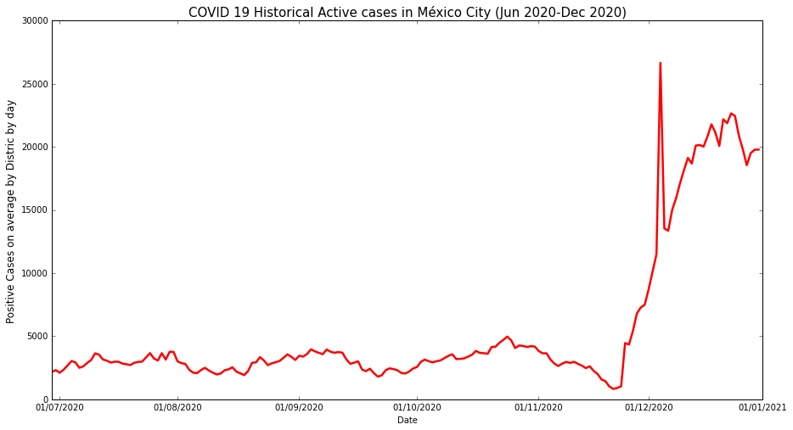
Covid-19 Evolution Across Mexico City
Since the beginning of the pandemic, Mexico City presented a total active daily cases of around 4,000.
However, by Q4, active daily cases rose dramatically, reaching a maximum of 26,000 by the end of December!
Source: SINAVE, 2021
Notes:
In this slide we visualive the evolution of total active cases in Mexico City from June to December of last year.
In the beginning of the pandemic and till November, we can observe an approximate of 4,000 active cases per day. This escalated to a max of 26,000 by the end of the year.
Important to mention is that in order to visualize this aesthetic chart you are seeing, we had to combine a number of csv files. This was a great opportunity to practice and use a for loop extracted and merged the data file by file.
I would say most of us have already seen a chart like this for the last couple months right?. Here we can see the evolution of (this is very important to understand) Total Daily active covid cases in Mexico city, this are not new cases, nor the accumulated sum of all cases. This is the daily active average, and just think about this, by the beginning of August, we had on average in a single Alcaldia, an average of 200 people sheltered and isolated, as the most strict requirements were followed, but, by the beginning of December, active cases growed really fast, and we got an average of 1300 people. That is only like 650% more.

Slide 7
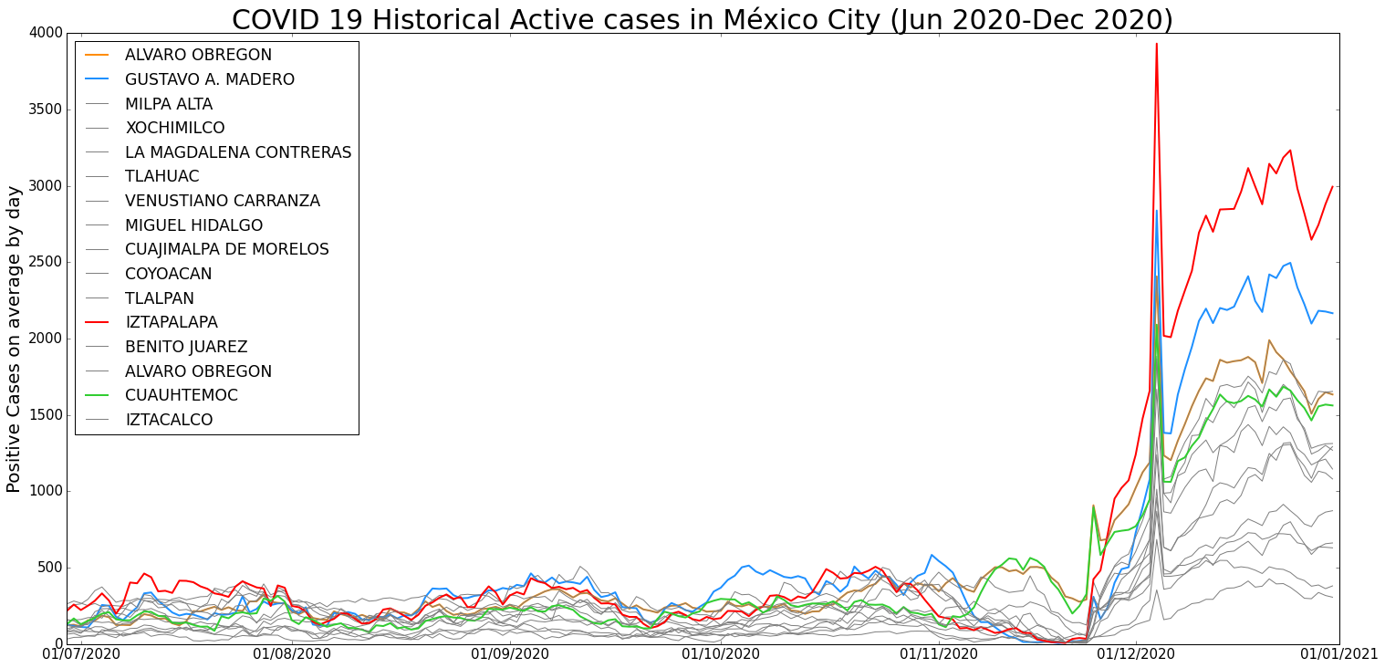
Covid-19 Evolution by District
During Q4 2020
1. IZTAPALAPA
2. GUSTAVO A. MADERO
3. ALVARO OBREGON
4. CUAUHTEMOC
Represent 40% of total active daily cases in México city.
Source: SINAVE, 2021
Notes:
Removing the total, here we can see a breaking down a view of each Alcaldia. This chart present the average daily cases by District.
This shows us, that at the beginning of August, each District had on average between 300 and 500 active cases by day, what happened next? This value rose to more than 2000 active cases by December.
During the last Quarter of 2020, Iztapala, Gustavo Madero, Alvaro Obregon and Cuauhtemoc represent 40% of total active daily cases.
And what can we understand from this chart?, well just that some Alcaldias have grown the number of active cases way faster than others. As an example of this, in December, only 4 Alcaldias had almost 40% of the total active cases in the while city. And we are saying that in the peak days of this period, there were over 1500-1600 people with the active virus. I want to say that just thinking about isolating and following strict restrictions with a family member or a friend has been hard, now imagine numbers like this, and also considering this were the active proven cases, right.

Slide 8
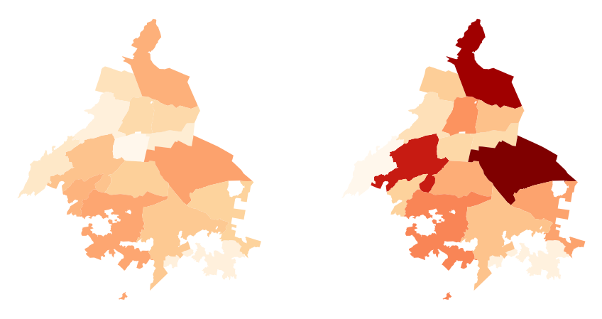
Covid-19 Evolution Across Mexico City
3rd Quarter 2020
4th Quarter 2020
3.7 THOUSAND ACTIVE DAILY CASES
13.6 THOUSAND ACTIVE DAILY CASES!
Figures Represent Mexico City 16 Districs
Q4 presented a daily average of active cases 367% larger to Q3 daily average!
Source: SINAVE, 2021

Slide 9
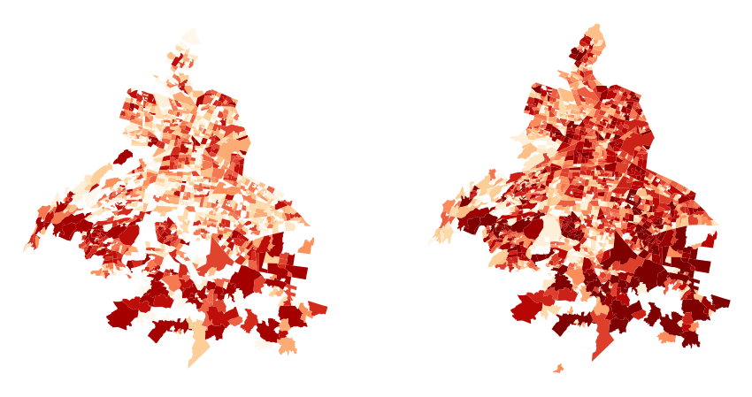
COVID-19 Evolution by Borough
3rd Quarter 2020
4th Quarter 2020
Average 1329 daily active cases in G. A. Madero boroughs
Figures Represent Mexico City over 1800 boroughs
Average 300 daily active cases in Iztapalapa boroughs
Average 1427 daily active cases in Iztapalapa boroughs
Average 295 daily active cases in Tlalpan boroughs
Average 1183 daily active cases in Álvaro Obregón boroughs
Most severely affected areas match the most socially vulnerable boroughs of the City.
Source: SINAVE, 2021

Slide 10
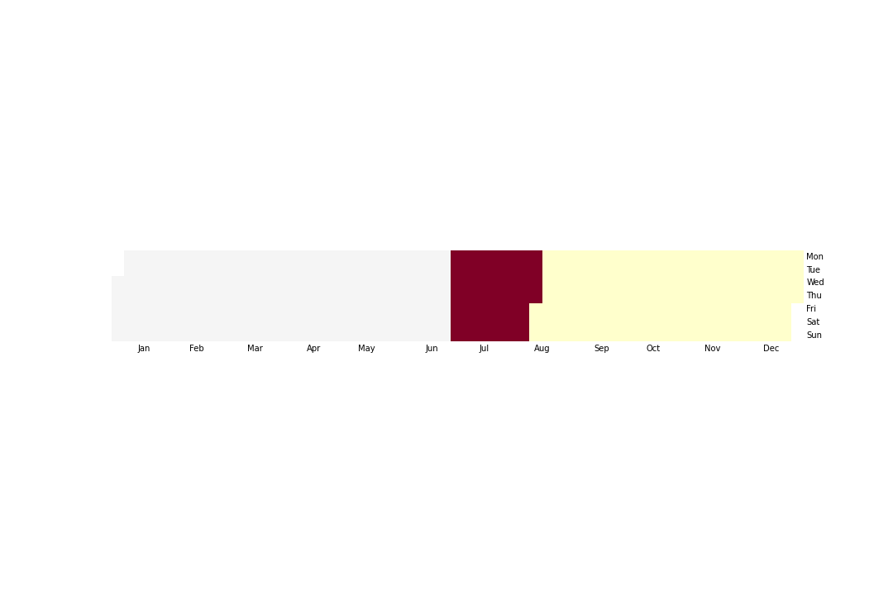
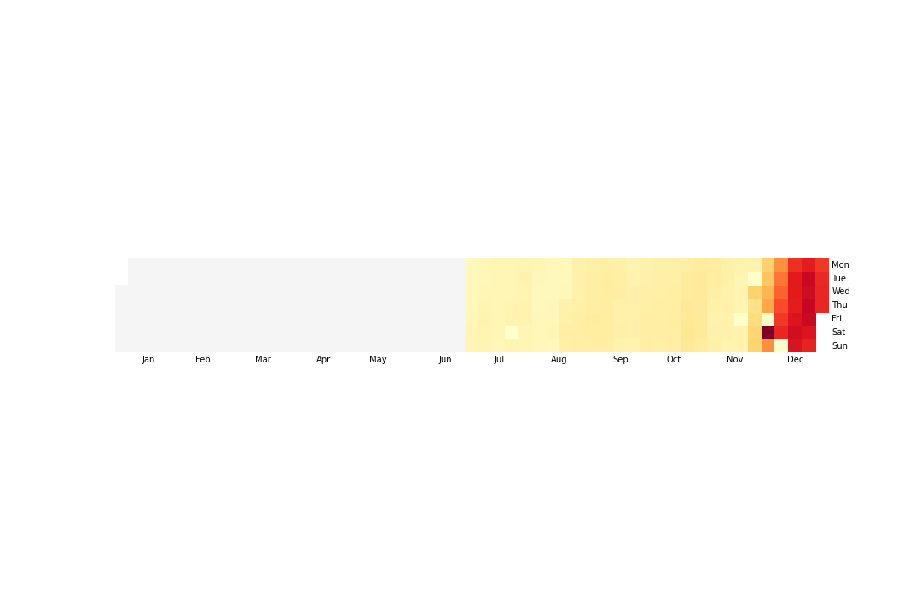
Government Restrictions
While in July government stop every social activity, population in December relax their precautions, increasing cases to a new “red flag” restrictions
Red flag
Yellow flag
Restrictions placed by Government
COVID 19 Cases
Source: SINAVE / INEGI 2021
Notes:
Now let's remove the average, and see one layer down, a view of each Alcaldia. And what can we understand from this chart?, that at least some of them have grown the number of active cases way faster than others. As an example of this, in December, only 4 Alcaldias had almost 40% of the total active cases in the while city. And we are saying that in the peak days of this period, there were over 1500-1600 people with the active virus. I want to say that just thinking about isolating and following strict restrictions with a family member or a friend has been hard, now imagine numbers like this, and also considering this were the active proven cases, right.

Slide 11
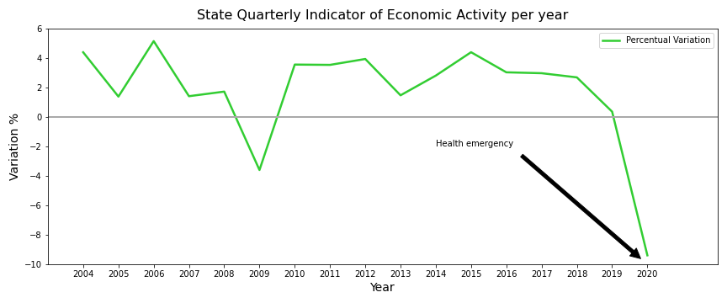
Economic Activity Metrics
The Covid-19 crisis represented the highest fall in Mexico City economic activity: a collapse even more dramatic that the 2009 subprime crisis.
Linea verde
Source: INEGI / Banxico 2021
Notes:
Now let's remove the average, and see one layer down, a view of each Alcaldia. And what can we understand from this chart?, that at least some of them have grown the number of active cases way faster than others. As an example of this, in December, only 4 Alcaldias had almost 40% of the total active cases in the while city. And we are saying that in the peak days of this period, there were over 1500-1600 people with the active virus. I want to say that just thinking about isolating and following strict restrictions with a family member or a friend has been hard, now imagine numbers like this, and also considering this were the active proven cases, right.

Slide 12
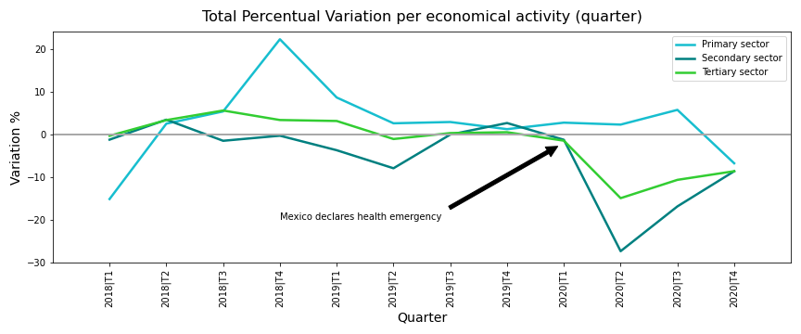
Economic Activity Metrics
In Mexico City, most of the economic activity sectors had negative growth during 2020, even after the flexibilization of lockdown measures.
Source: INEGI / Banxico 2021
Notes:
Now let's remove the average, and see one layer down, a view of each Alcaldia. And what can we understand from this chart?, that at least some of them have grown the number of active cases way faster than others. As an example of this, in December, only 4 Alcaldias had almost 40% of the total active cases in the while city. And we are saying that in the peak days of this period, there were over 1500-1600 people with the active virus. I want to say that just thinking about isolating and following strict restrictions with a family member or a friend has been hard, now imagine numbers like this, and also considering this were the active proven cases, right.

Slide 13

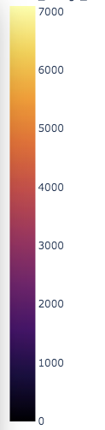
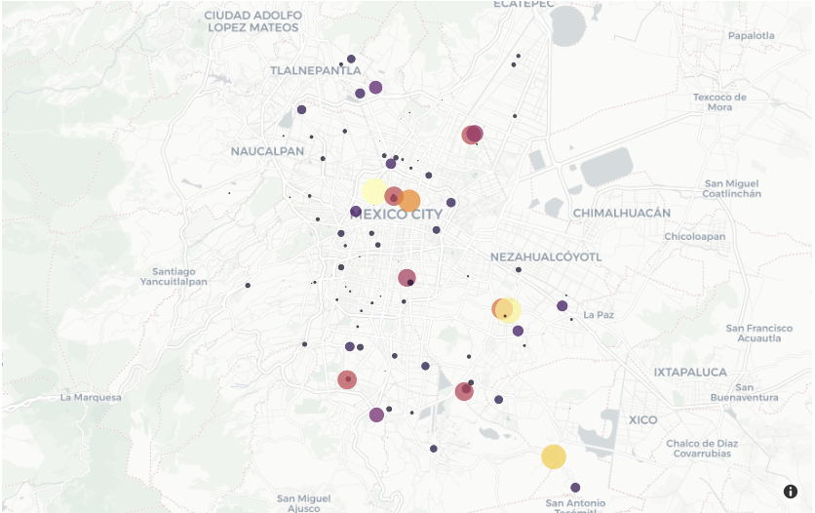
Proximity Street Markets In Mexico City
How is Covid-19 increase in cases related to informal and street economic activity?
Over 218 “Tianguis” identified across Mexico City with Google Places API.
Bubble size & color represents amount of User Ratings in Google Places, as a proxy of “crowdedness”
Source: Google 2021

Slide 14
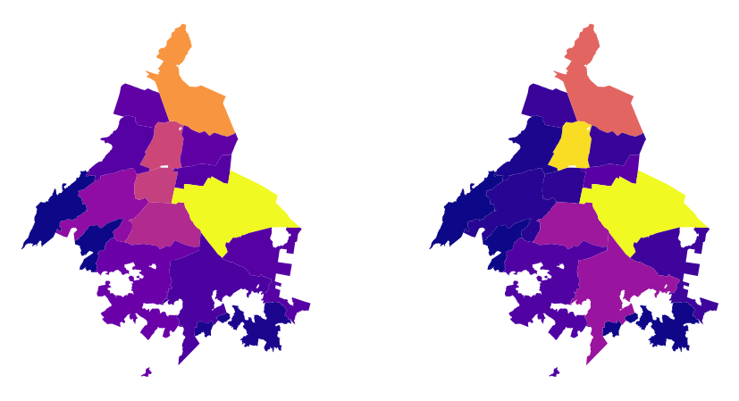
Proximity Street Markets In Mexico City
“Tianguis” Total Count by District
“Tianguis” Total Amount of Google Reviews by District *
LOW
HIGH
Iztapalapa and G.A. Madero are the districts with more street markets operational.
The most crowded and popular street markets are located in Iztapalapa, G.A. Madero and Cuauhtémoc districts
Districts with the higher amount of street market activity tend to match with those with high levels of daily active Covid cases.
Source: Google 2021

Slide 15


Discussion
The present study explores some ideas that are part of an ongoing debate on governments’ agendas across the globe…
What is the impact of lockdown measures on economic activities and what is the real toll when considering a global sanitary crisis without precedents in the XXIst century?
We found the expected correlation
The greater the cases, the greater the quantity and severity of government restrictions, the lower economic activity gets.
Notes:
There is a clear view of all this, our 3 subjects are very related, Covid 19 cases have become a crisis that Mexican government had tried to control and maintain, and we know this is not an easy task, as we know this topic has become one of the most difficult challenges many countries and governments have faced since the last year.

Slide 16

Q&A with the audience

Slide 17
Appendix 1
All the project workbooks, files and results supporting the present slideshow can be accessed in the following GitHub repository:
https://github.com/martinsingla/data-project

Slide 18

Appendix 2
Study Limitations & Further Research / Post-mortem
Low quality Data Sources
Difficult to find disaggregated data by neighborhood
Inconsistent continuity in dates
Duplicated and inaccurate data
Measuring Economic activity
Correct way to measure economic activity
Additional questions that came up
How different has changed the active cases during 2021?
How does other countries have faced Covid cases in economic perspectives?

